Slide 1
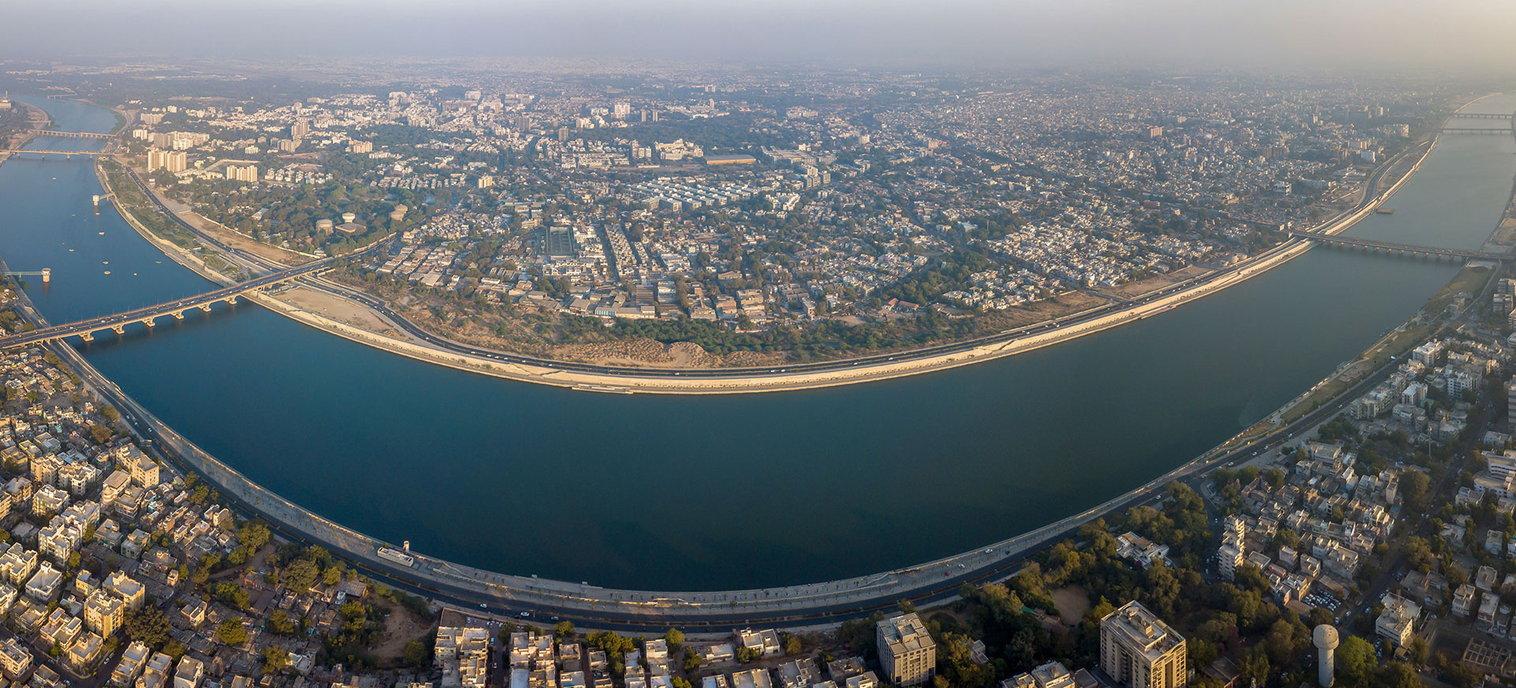
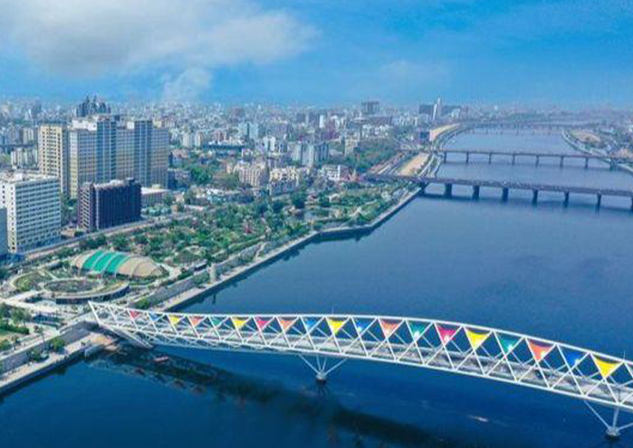
River font
Riverfont Project
By. Mahendra Singh

Slide 2
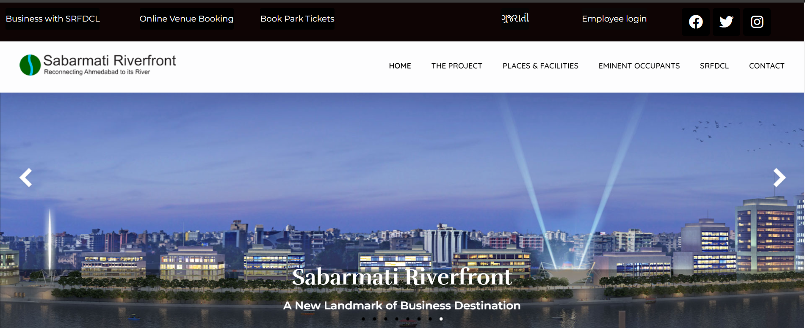
About us
About Us
In May 1997, the Ahmedabad Municipal Corporation launched a Special Purpose Vehicle (SPV) - the Sabarmati Riverfront Development Corporation Limited (SRFDCL) under Section 149(3) of the Indian Companies Act, 1956.
The project aims to provide Ahmedabad with a meaningful waterfront environment along the banks of the Sabarmati River and to redefine an identity of Ahmedabad around the river. The project has reconnected the city with the river and has positively transformed the neglected aspects of the riverfront.

Slide 3

Languages
HTTML
CSS
JAVASCRIPT
JQUERY

Slide 4
Quick Links
Address
The Project Places & Facilities SRFDCL Contact FAQs Tenders Recruitment Online Booking
SABARMATI RIVER FRONT DEVELOPMENT CORPORATION LIMITED (hereinafter referred to as "SRFDCL") 2nd Floor, "Riverfront House" Pujya Pramukh Swami Marg (River Front Road - West) Ahmedabad - 380009 GUJARAT INDIA. CIN - U73100GJ1997PLC032419

Slide 5


